Slide 1
Advanced TCP/IP

Slide 2
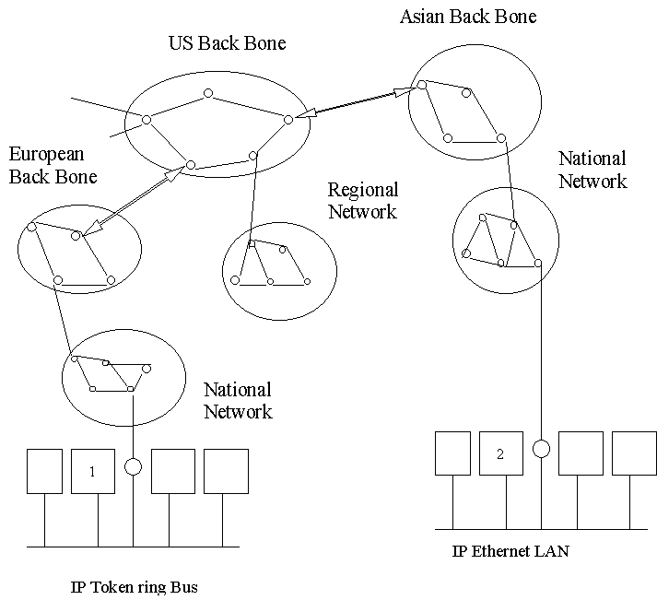
INTERNETWORKING

Slide 3
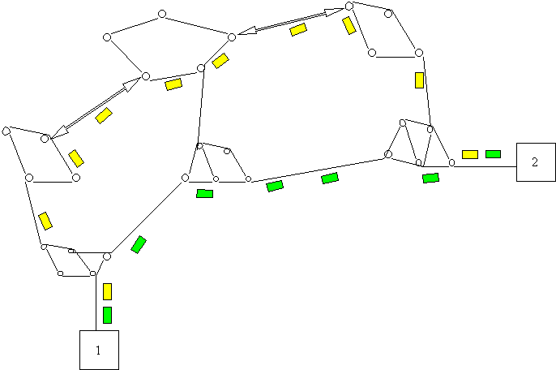
Connectionless communication of packets

Slide 4
A simple network with two routers
Router 1
LAN 1
190.20.2.0
User Host
190.20.2.12
Wide Area Network
LAN 2
14.2.6.0
LAN 3
14.2.9.0
Router 2
File Server
14.2.9.10

Slide 5
Communication Protocols
In a complex network such as Internet, the transmission paths within networks are specified by a process known as Routing.
For this purpose , there are special computers known as Routers at the junction between two or more networks, which can determine the route of data.
The route can be determined according to a table known as Routing table which may be a Static or Dynamic.
Security of the router and their configuration settings are vital in network operation.

Slide 6
Routed protocol and Routing protocol
Routed protocol
  The protocols that can be routed by a router.
  Examples: IP,IPX,AppleTalk etc.
Routing protocol
  Gathers information about available networks and distance to reach
  Supports the Routed protocols and used to maintain routing tables
  Examples:RIP(Routing Information Protocol)
  RFC 1088,1388 and 1723
  OSPF(Open Shortest Path First)
  RFC 2328

Slide 7
TCP/IP: An overview
Transmission Control Protocol /Internet Protocol (TCP/IP) is not a single protocol. It refers to a suit of Protocols.
TCP/IP was first implemented in early 1980’s for the version of UNIX written at University of California at Berkley known as Berkley Software Distribution(BSD).
As use of TCP/IP services are increasing day by day, concern for its negative consequences are also increasing.

Slide 8
TCP/IP: an overview
TCP/IP protocol is the language of any computer network can be equally used in both LAN and WAN .
TCP/IP protocol and technology are inherently designed to be open.
TCP/IP is a protocol for connectionless communication.
In TCP/IP Data are broken up into packets which travel freely over the network seeking the best possible route to reach their final destination.
Unless proper precautions are taken, data can readily be intercepted and /or altered, often without the sending or receiving parties being aware of the security breach.
TCP/IP is the main source of Network Vulnerabilities.

Slide 9
TCP/IP : an overview
Any thing that can learn to “speak TCP/IP” can play on the Internet.
Most common services:
  E-mail,through SMTP
  TELNET for remote terminal access
  HTTP for Information based services
  FTP for retrieve or store files on networked system.

Slide 10
OSI Reference Model
The Open System Interconnection (OSI) reference model was developed by International Organization for Standardization (ISO) in 1984

Slide 11
OSI Reference Model
OSI Model
7
Application
6
Presentation
5
Application
Session
4
Transport
3
Network
2
Datalink
1
Physical

Slide 12
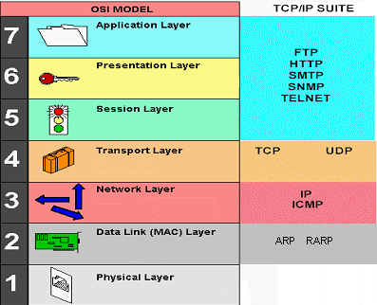
OSI Model & TCP/IP SUIT
OSI Model
TCP/IP SUIT
Application
Transport
Network
Link

Slide 13
Encapsulation and Decapsulation
User data
Application
Appln
header
User data
Application data
TCP
TCP header
Appln
header
User data
TCP SEGMENT
IP
IP header
TCP header
Appln
header
User data
IP DATAGRAM
Ethernet driver
Ethernet header
IP header
TCP header
Appln
header
User data
Ethernet trailer
Ethernet
14
20
20
ETHERNET FRAME
4

Slide 14
Maximum Transfer Unit(MTU)
Feature of the link layer
Path MTU
  Smallest MTU in the path
  May not be same from A-B as from B-A
The MTU varies from one to other media of transmission.
  For ISDN BRI/PRI MTU is 1500 bytes.
  For 10/100 M Ethernet MTU is 1500 bytes.
  For X.25 MTU is 576 bytes.
  For Hyper Channel MTU is 65535 bytes.

Slide 15
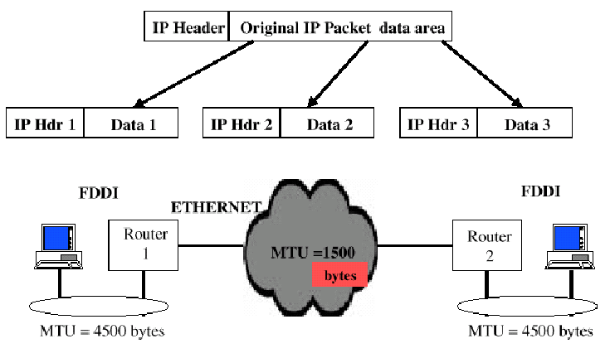
IP Fragmentation

Slide 16
IP Fragmentation
Minimum size of IP packet is 20 bytes, if no options are specified.
Maximum size of IP packets can be up to 65,535 (2¹⁶- 1) bytes.
Packets bigger than Maximum Transmission Unit (MTU) are fragmented into smaller packets.

Slide 17
IP Fragmentation
All fragmented packets will have the same IP header
At destination packets are reassembled using
  Identification number
  Offset number

Slide 18
ARP
(Address Resolution Protocol )
32 bit IP address
192.168.100.201
RARP
ARP
00-D0-59-4A-03-6E
48 bit MAC address

Slide 19
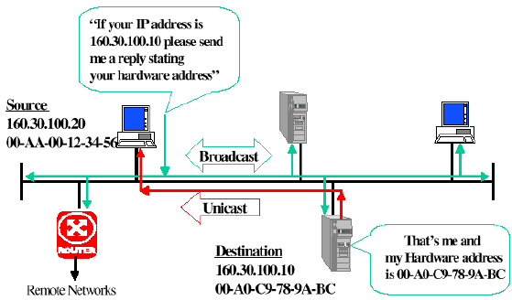
ARP
(Address Resolution Protocol )

Slide 20
ARP request / reply packet
Hardware address type
Protocol address type
H/w address length
Proto address length
Option code
Source hardware address (48 bits)
Source IP address (32 bits)
Destination hardware address (48 bits)
Destination IP address (32 bits)
32 bits

Slide 21
ARP cache
To show all entries
  Arp –a
2-10 minute timeout
Cache updated
  when it receives an arp request broadcast
  When an ARP reply is received

Slide 22
IP
Handles Datagrams
Is unreliable
  No guarantee for packet delivery
Is Connectionless
  Each datagram is handled independently
  Two packets from same source to same destination could get routed differently
  Packets arrive out of order

Slide 23
IP header
0
7
8
15
16
31
Version
Header
Length
Type OF Service
Total Length(in bytes)
Identification
Flags
Fragment offset
Time To Live
Protocol
Header Checksum
20
Bytes
Source IP address
Destination IP address
Options (if any)
Data
32 bits

Slide 24
Options field in IP header
Is used for
  Record Route option
  Timestamp recording
  Source routing

Slide 25
ICMP
Part of IP Layer
Communicates a range of conditions
  Fatal errors to informational messages

Slide 26
ICMP message types
Query/Response
  Echo request/echo reply
  Timestamp request/timestamp reply
Error message
  Host unreachable
  TTL expired in transit

Slide 27
ICMP message format
IP Datagram
IP Header (20 bytes)
ICMP Message
TYPE (8 bits)
CODE (8 bits)
CHECKSUM (16 bits)
Contents (size depends on type and code)
ICMP Message

Slide 28
ICMP error message
Contents
  Original IP header
  First 8 bytes of the original IP datagram data
  For which the error is generated

Slide 29
Sample ICMP error message
0
7
8
15
16
31
Type
Code
Checksum
8 bytes
Unused
Original IP header + first 8 bytes o IP datagram data

Slide 30
ICMP query / response messages
0
7
8
15
16
31
Type(8)
Code(8)
Checksum(16)
Identifier(16)
Sequence Number(16)
8 bytes
Query/Response Data

Slide 31

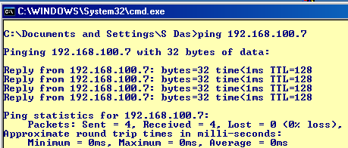
PING
ICMP ECHO Request
ICMP ECHO Reply

Slide 32
PING
Used to
  Test destination reachability
  Compute round trip time
  Count the number of hops to destination
Multiple ping sessions in same host
  separated using ID number field

Slide 33
Traceroute
Exploits TTL and ICMP
  Send packet with TTL=1
  First router discards packet and sends “TTL exceeded message”
  Send packet with TTL=2..etc

Slide 34
Traceroute
Router 1
UDP TTL=1
UDP TTL=2
ICMP TTL Exp
Host A
Router 2
ICMP TTL Exp
Traceroute from A to B
Host A
Router 1
Router 2
Host B
UDP TTL=3
ICMP TTL Exp
Host B

Slide 35
UDP
Connectionless end-to-end service
No flow control
No error recovery
Used by SNMP, DNS, TFTP

Slide 36
UDP header
0
15
16
31
Source port number (16 bit)
Destination port number (16 bit)
8 bytes
Total length (16 bit)
Checksum (16 bit)
D A T A

Slide 37
TCP
Connection(session) Oriented
  Reliable startup
  Graceful shutdown
Point-to-Point
  (no broadcast or multicast)
Full duplex communication

Slide 38
TCP’s reliability
Reliability in data transfer is achieved by
  Establishment of a session at startup
  Checksum for error detection
  Sequence numbers
  Window flow control
  Graceful shutdown/end of session.

Slide 39
TCP header
0
15
16
31
Source port number (16 bit)
Destination port number (16 bit)
Sequence number (32 bit)
Acknowledgement number (32 bit)
20 bytes
Header
length (4)
Reserved
(6 bits)
URG
ACK
PSH
RST
SYN
FIN
Window size (16 bit)
TCP Checksum (16 bit)
Urgent pointer (16 bit)
O P T I O N S
D A T A

Slide 40
Port Number
The port number along with network identifier (IP) and computer system identifier (Service) forms the communication end points.
Every computer system has various Port Numbers at their disposal.
A Port Number is comprised of 16 bits
Theoretically, a computer system with an IP address is able to establish 65535 connections to other communication end points at the same time.

Slide 41
Port Number
The Privileged Ports (usually <1023), are reserved for certain services on the server and known worldwide. A client can get those services through such ports.
To the client side the port numbers are dynamically assigned with a value (>1023) and called as Unprivileged ports.

Slide 42
Port Number
APPLICATION LAYER
FTP
FTP
DATA
TELNET
SMTP
NNTP
----
21
20
23
25
119
----
TRANSPORT LAYER
IP addresses
NETWORK LAYER
LINK LAYER (MAC)
Mac add
IP Header
TCP/UDP
Header
DATA

Slide 43
Connection Establishment
Three way handshake
  Client sends SYN
  Server ACKs the SYN, also sets the SYN bit and its own ISN number
  Client ACKs the reverse direction SYN
Total 3 segments transmitted

Slide 44
Connection termination
  Client sends FIN
  Server ACKs this and notifies the application
  Server application issues a “CLOSE” and server sends FIN to client
  Client ACKS this
Total 4 segments transmitted

Slide 45
TCP states
Connection Establishment
  LISTEN – Server is ready to accept
  connections
  SYN_SENT - Indicates active open
  SYN_RCVD – Server just received SYN
  from client
  ESTABLISHED – Client received servers
  SYN and session is
  established

Slide 46
TCP states
Connection termination
  FIN_WAIT_1- Indicates active close
  TIMED_WAIT– Client is in this state after
  active close
  CLOSE_WAIT– Server just received FIN
  from client
  LAST_ACK - Server just send its own FIN
  CLOSED - Server received ACK from client

Slide 47
Connection establishment
Client
Server
SYN_SENT
S Y N
LISTEN
SYN_RCVD
S Y N A C K
ESTABLISHED
A C K
ESTABLISHED

Slide 48


Connection establishment
Sequence no. and Acknowledgement no.
SYN bit set , SEQ# = 65
ACK# = 66,SYN bit set, ACK bit set , SEQ# = 102
ACK# =103, ACK bit set
DATA TRANSFER

Slide 49
Connection termination
Client
Server
FIN_WAIT1
F I N
CLOSE_WAIT
A C K
FIN_WAIT2
F I N
TIME_WAIT
A C K
CLOSED

Slide 50
Half Open,Half Close
Half Open
  One side crashed and lost memory of connection while other thinks its open, eventually it times out
Half Close
  Possible for one end to close while the other end sends data

Slide 51
TCP FLAGS
URG : The urgent pointer is valid
ACK : The acknowledgement number is valid
PSH : The receiver should pass the data to
application as soon as possible
RST : Reset the connection
SYN : Synchronize sequence number to
initiate connection
FIN : The sender finished sending data

Slide 52
DNS
Name to IP address mapping
DNS is hierarchical
DNS
  Query response (UDP 53)
  Zone transfer (TCP 53)

Slide 53
TELNET
TELNET allows an user(Client) to have a terminal session on a remote system(Server)
A TCP session is first established between the client and port 23 of the server followed by a login sequence during which the user has to identify and authenticate himself through “USER NAME” and “PASSWORD”
Password is transmitted in clear text.
An attacker, if can sniff, an authorized TELNET connection can get the “PASSWORD”

Slide 54
TELNET
Source port = 4023
Destination port = 23
Source port = 23
Destination port = 4023
Client
Server

Slide 55
The Web: HTTP Protocol
http: hypertext transfer protocol
Web’s application layer protocol
client/server model
  client: browser that requests, receives, “displays” Web objects
  server: Web server sends objects in response to requests
http1.0: RFC 1945
http1.1: RFC 2068
http request
PC running
Explorer
http response
http request
Web
server
http response
Mac running
Navigator

Slide 56
HTTP Protocol
http: TCP transport service:
client initiates TCP connection (creates socket) to server, port 80
server accepts TCP connection from client
http messages (application-layer protocol messages) exchanged between browser (http client) and Web server (http server)
TCP connection closes

Slide 57
http example
URL:www.mycompany.com/department/home.index
(contains text,
references to 10
jpeg images)
Client
Server
1a. http client initiates TCP connection to http server (process) at www.mycompany.com. Port 80 is default for http server.
1b. http server at host www.someSchool.edu waiting for TCP connection at port 80. “accepts” connection, notifying client
3. http server receives request message, forms response message containing requested object (Department/home.index), sends message into socket
2. http client sends http request message (containing URL) into TCP connection socket
5. http client receives response message containing html file, displays html. Parsing html file, finds 10 referenced jpeg objects
4. http server closes TCP connection.
6. Steps 1-5 repeated for each of 10 jpeg objects

Slide 58
http message format: request
request line
(GET, POST,
HEAD commands)
GET /somedir/page.html HTTP/1.0
User-agent: Mozilla/4.0
Accept:text/html,image/gif,image/jpeg
Accept-language:fr
(extra carriage return, line feed)
header lines
Carriage return,
line feed
indicates end
of message

Slide 59
http message format: response
status line
(protocol
status code
status phrase)
HTTP/1.0 200 OK
Date: Thu, 06 Aug 1998 12:00:15 GMT
Server: Apache/1.3.0 (Unix)
Last-Modified: Mon, 22 Jun 1998 …...
Content-Length: 6821
Content-Type: text/html
header lines
data, e.g.,
requested
html file
data data data data data ...

Slide 60
FTP
TCP based
Consists of
  Control connection
  Data connection
Active FTP
  TCP 21 (Control Connection)
  TCP 20 (Data connection)
Passive FTP
  TCP 21 (Control Connection)
  TCP > 1024 (Data connection)

Slide 61
Active FTP
Server
Client
20
DATA
21
Control
4320
4321
PORT 4321
OK
DATA TRANSFER

Slide 62
Passive FTP
Server
Client
DATA
2882
21
Control
4320
4321
“PASV”
OK 2882
Connection
DATA

Slide 63
FTP: commands
Sent as ASCII text over control channel
USER username
PASS password
LIST return list of file in current directory
RETR filename retrieves (gets) file
STOR filename stores (puts) file onto remote host

Slide 64
FTP: responses
Sample return codes
status code and phrase (as in http)
331 Username OK, password required
125 data connection already open; transfer starting
425 Can’t open data connection
452 Error writing file

Slide 65
FTP Vulnerabilities
Clear text passwords
Buffer overflow
Unauthorized access
Denial of service

Slide 66
FTP : How to protect
Upgrade to latest version
Disable anonymous ftp
Use filtering
Disable unused ftp servers
Use sftp

Slide 67
SMTP: Electronic Mail
User agent
Three major components:
user agents
mail servers
simple mail transfer protocol: smtp
User agent
mail server
User agent
SMTP
mail server
SMTP
User agent
SMTP
mail server
User agent
outgoing
message queue
user mailbox

Slide 68
SMTP: Electronic Mail
User agent
User Agent
mail reader
composing, editing, reading mail messages
e.g., Eudora, Outlook, elm, Netscape Messenger
outgoing, incoming messages stored on server
User agent
mail server
User agent
SMTP
mail server
SMTP
User agent
SMTP
mail server
User agent
outgoing
message queue
user mailbox

Slide 69
SMTP: Electronic Mail
User agent
Mail Servers
mailbox contains incoming messages (yet to be read) for user
message queue of outgoing (to be sent) mail messages
smtp protocol between mail servers to send email messages
  client: sending mail server
  “server”: receiving mail server
User agent
mail server
User agent
SMTP
mail server
SMTP
User agent
SMTP
mail server
User agent
outgoing
message queue
user mailbox

Slide 70
SMTP : Electronic Mail
Uses tcp . Client sends mail to server port 25
Direct transfer: sending server to receiving server
Three phases of transfer
  handshaking (greeting)
  transfer of messages
  closure
Command/response interaction
  commands: ASCII text
  response: status code and phrase
Messages must be in 7-bit ASCII

Slide 71
Sample SMTP Interaction
S: 220 hamburger.edu
C: HELO crepes.fr
S: 250 Hello crepes.fr, pleased to meet you
C: MAIL FROM: <alice@crepes.fr>
S: 250 alice@crepes.fr... Sender ok
C: RCPT TO: <bob@hamburger.edu>
S: 250 bob@hamburger.edu ... Recipient ok
C: DATA
S: 354 Enter mail, end with "." on a line by itself
C: Do you like ketchup?
C: How about pickles?
C: .
S: 250 Message accepted for delivery
C: QUIT
S: 221 hamburger.edu closing connection

Slide 72
SMTP: commands
HELO
MAIL FROM
RCPT TO
DATA
QUIT
above lets you send email without using email client (reader)

Slide 73
SMTP Vulnerabilities
Relay server
Configuration mistakes
Buffer overflow

Slide 74
SMTP :How to protect
Upgrade to latest version
Relay configurations

Slide 75


Mail access protocol
User agent
SMTP
SMTP
User agent
POP3 or
IMAP
sender’s mail
server
receiver’s mail
server
SMTP: delivery/storage to receiver’s server
Mail access protocol: retrieval from server
  POP: Post Office Protocol [RFC 1939]
    authorization (agent <-->server) and download
  IMAP: Internet Mail Access Protocol [RFC 1730]
    more features (more complex)
    manipulation of stored msgs on server
  HTTP: Hotmail , Yahoo! Mail, etc.

Slide 76
SNMP
Used in network management
Components
  Manager, Agents and MIB
Works as an application protocol running over UDP
One manager can handle hundreds of agents

Slide 77
SNMP Vulnerabilities
Unencrypted password
Default password
Handling of trap messages
Mapping of network
Denial of service

Slide 78
SNMP: How to protect
Use SNMP v3
Disable SNMP if not required
Filter ports
Use strong community strings

Slide 79
Attacks on Network

Slide 80


Attacks on a Network
Passive attack
Active attack

Slide 81
Passive Attack
LAN is configured in such a way that all packets move over the network can be captured by attacker.
Software packages are available mainly for maintenance purpose to monitor network traffic can be used for eavesdropping and capturing password as part of passive attack

Slide 82
Passive Attack
Packet sniffing
  Packet sniffing is a software application uses network card in promiscuous mode to capture all traffic that are sent across a particular collision domain .
  Legitimately used for for troubleshooting
  As several applications like telnet.FTP,SMTP,POP3 etc. send data in clear text , a packet can provide meaningful and often sensitive information like username and password.
  Many users employ a single password for accessing all accounts.
  Same authentication information (I.e., username /password) can be used to gain access to other corporate or external resources.

Slide 83
Defence against Passive Attack
ONE TIME PASSWORD
  OTP is a two factor authentication
  Makes use of PIN and a token device which generates a new seemingly random password for a specified interval
  User combines the random password generated by token device and PIN to create an unique password that only works for instance of authentication.

Slide 84
Defence against Passive Attack
Switched Network
  Deployment of switched Ethernet infrastructure can limit the unauthorised sniffing access to the traffic that flows on the specific port to which they connect.
  It does not eliminate the threat completely but can greatly reduce their effectiveness.
Anti-sniffer Tool

Slide 85
Network Reconnaissance
Overall act of learning information about a target network by using publicly available information.
Before launching an attack, following steps are followed
  DNS Queries
  Database search (www.netcraft.com)
  Ping sweep
  Port Scanning

Slide 86
Active attack
Denial of service attacks (DoS)
Causes a network or computer incapable of providing normal service
The nastiest attack, easy to launch and most difficult to track.
Target is network bandwidth or connectivity

Slide 87
Active attack
Distributed Denial of service attacks (DDoS)
DDOS attack uses many computers to launch a coordinated DoS attack against a single or more target.

Slide 88


Distributed Denial of Service (DDoS)
Attacker
Masters
Daemons
Victim

Slide 89
Common DoS Attacks
SYN Flood
Ping of Death
SMURF

Slide 90
syn flood attack
Attacker sends SYN packet to victim with spoofed source address of a non existent system
Victim sends SYN_ACK and is in SYN_RECV state
The ACK never comes; nor a RST
The connection is flushed after a timeout varying from 75 seconds to 25 minutes
Number of half open connections is limited
Prevents new connections to the port

Slide 91
Preventing syn flood
Reduce connection establishment timeout
Increase connection queue
Employ TCP intercept
Employ connection proxy at firewall
  SYN defender in Checkpoint FW-1

Slide 92
Ping of Death
Exploits the fragmentation vulnerability of large ICMP ECHO request packets(“ping”)
A ICMP EHCO request packet consists of 8 byte of ICMP header followed by the data bytes.
Maximum allowable size of the data area for an ICMP message is 65507 bytes (= 65535 -20 -8 ).
It is possible to send an illegal ICMP ECHO packet with more than 65507 byte of data, so IP does fragmentation.

Slide 93
Ping of Death
The fragmentation relies on an offset value in each fragment to determine where the individual fragment goes for reassembling.
The receiving machine does not process the packet until it receives all the fragments
While reassembling the fragments, the size of the ‘would be’ IP packet becomes illegal and this can cause the victim to crashes, hang, reboot and other unwanted behaviour.

Slide 94
Countermeasure for Ping of death attack
This attack has however been around for quite sometime and all operating system have released the fixes to rectify this problem
The ‘Ping of Death’ attack can be fixed alternately by configuring the firewall to drop all incoming ICMP requests .
The best defense is to install latest patches in this regard of the operating system .
(Linux community have roll out a patch within 4 hours of being notified of the problem )

Slide 95
SMURF Attack
The source address in the ICMP ECHO request is modified to target address.
Ping (ICMP ECHO request) is sent to one or more network of computers
All the recipients of ‘ping’ will then respond(ICMP ECHO reply) to the computer under attack (target).
The forged source address (target) will be overwhelmed by the response traffic.

Slide 96
SMURF Attack
ICMP ECHO Request
(In broadcast mode)
SA: TARGET
SMURF Platform
ICMP ECHO Reply
ATTACKER
TARGET

Slide 97
Thank you

